Slide 1
Factors associated with stopping HIV pre-exposure prophylaxis (PrEP) for three months or more in the EPIC-NSW trial
Benjamin R Bavinton, Stefanie Vaccher, Garrett P Prestage, Martin Holt, Rebecca Guy, Janaki Amin, Iryna B Zablotska-Manos, Christine Selvey, Andrew Carr, Catriona Ooi, Andrew E Grulich, for the Expanded PrEP Implementation in Communities New South Wales (EPIC-NSW) research group
10th IAS Conference on HIV Science | 23 July 2019

Slide 2
Disclosures
Gilead Sciences donated 2,000 person-years of study drug (TDF/FTC) for EPIC-NSW.
Honoraria for educational presentations (unrelated to the present work):
  Gilead Sciences (2019)
  Pharmaceutical Society of Australia (2018-2019)
Research grants (unrelated to the present work):
  Gilead Sciences (2016)
  ViiV Healthcare (2016)

Slide 3
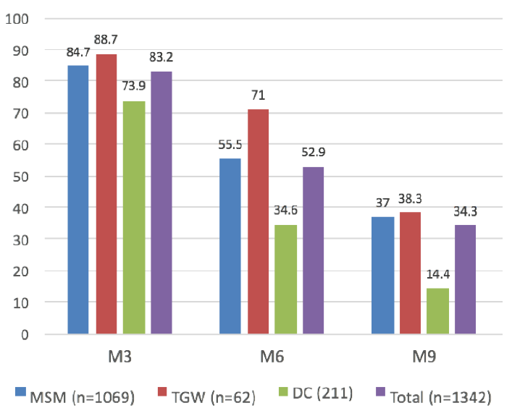
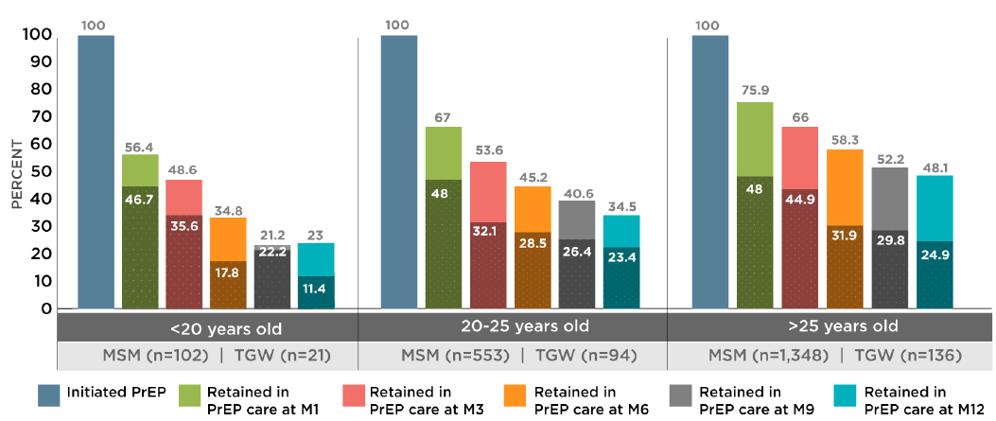
Background
PrEP is highly effective at preventing HIV and is being scaled-up globally in many countries among populations with higher risk of HIV acquisition.
Key challenges to the success of PrEP programs include adherence to PrEP when people are taking it, and retention on PrEP over the longer term.
Vietnam
Thailand
K Green, 2019, IAS Conference; T Chinbunchorn, 2019, First Indonesian PrEP Sympoisum

Slide 4
Background
PrEP is highly effective at preventing HIV and is being scaled-up globally in many countries among populations with higher risk of HIV acquisition.
Key challenges to the success of PrEP programs include adherence to PrEP when people are taking it, and retention on PrEP over the longer term.
But… It should be noted that retention itself is not the goal.
  At the individual level, retention on PrEP is only necessary when HIV risk is high.
Misestimation of ongoing ‘high risk’ among individuals taking PrEP may be a problem.
  Individuals may choose to stop PrEP when they believe they are no longer are high risk, but are mistaken.
  Individuals may have correct perception of their risk as ‘low’ when they stop PrEP, but have increased risk at a later point.

Slide 5
Aims
In this analysis, we explored factors associated with stopping PrEP for at least 3 months in the EPIC-NSW trial.
  Factors differentiating those with any stop of at least 3 months and those with no reported stop in PrEP use.
  Examination of sexual behaviours in those periods where PrEP was stopped.

Slide 6
Methods: EPIC-NSW
EPIC-NSW study design and aims
EPIC-NSW (Expanded PrEP Implementation in Communities in New South Wales) was a single-arm, open-label implementation trial of daily PrEP.
Primary research question:
What is the population-level effect of rapid, targeted, high-coverage PrEP rollout on new HIV diagnoses in NSW?
EPIC-NSW recruited from 1 March 2016 to 30 April 2018.

Slide 7
Methods: EPIC-NSW
PrEP eligibility criteria
In Australia, PrEP is targeted toward high-risk individuals, using local clinical/prescribing guidelines.
High-risk behaviour in past 3 months | Estimated HIV incidence
Rectal chlamydia or rectal gonorrhoea; infectious syphilis | 3.6-7.0 per 100 PY
Condomless anal intercourse with an HIV positive regular partner with detectable viral load | 5.4 per 100 PY
Receptive condomless anal intercourse with casual partners (HIV status unknown or HIV positive) | 2.3 per 100 PY
Use of crystal methamphetamine | 1.9 per 100 PY
Wright et al., 2017, J Virus Erad

Slide 8
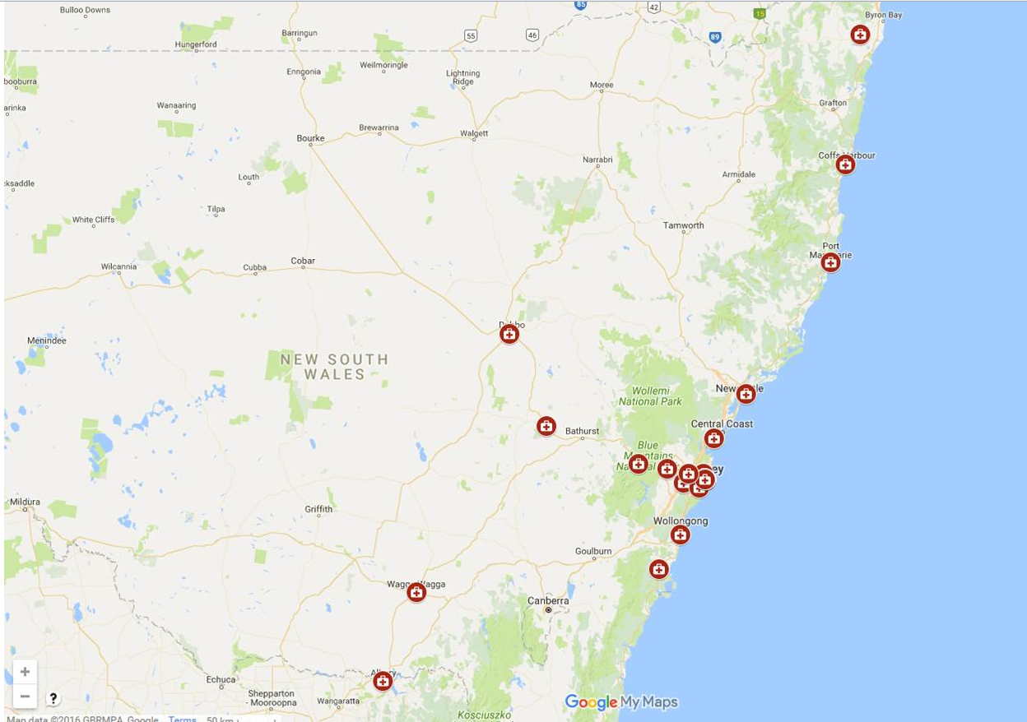
Methods: EPIC-NSW
Recruiting sites
31 clinics around NSW.
Mixture of publicly-funded
sexual health clinics,
private general practice
(GP) clinics, and hospital
clinics.

Slide 9
Methods: EPIC-NSW
Inclusion and exclusion criteria
Inclusion criteria
  At high and ongoing risk according to guidelines
  Aged 18 or older
  Fourth generation HIV antibody/antigen negative
Exclusion criteria
  Symptoms of acute HIV infection
  eGFR of less than 60mL/min/1.73m²

Slide 10
Methods: EPIC-NSW
Procedures
Participants attended clinic visits at baseline, 1 month, and every 3 months thereafter.
Tests:
  HIV (every visit)
  STIs according to local guidelines (every 3 months)
  Hepatitis C according to local guidelines (annually)
  Creatinine clearance (every 6 months)
Clinical data were extracted from electronic medical records.
Participants were invited at baseline to consent to optional online quarterly surveys about behaviour and PrEP use.
  Survey questions were minimal (~5 minutes to complete).

Slide 11
Methods: This analysis
Analysis
Primary outcome variable for this analysis was self-reported from the survey data:
Not taking any PrEP pills in the three months prior to the survey.
Analysis was restricted to:
  Participants who consented to complete the online surveys
  Participants who had been enrolled in EPIC-NSW for at least 18 months
  Participants who had completed at least one survey at least 18 months after enrolment.
Associations with stopping PrEP for at least 3 months were explored with generalised estimating equations (GEE) to control for repeated measures.
Analysis was conducted in Stata (version 14).

Slide 12
Results
Enrolment
9,243 enrolled
5,010 enrolled
March 2016
March 2017
March 2018

Slide 13
Results
Enrolment and sub-sample derivation
9,706 enrolled
9,243 enrolled
8,566 consented
to surveys
3,185 had at least one PrEP dispensing ≥18 months after enrolment
5,010 enrolled
1,682 completed ≥1 survey
≥18 months after enrolment
March 2016
March 2017
March 2018

Slide 14
Results
Demographics (and comparison with excluded participants)
 | Included
Median age (IQR) | 39 (32-47)
Australian-born | 61.8%
Lives in ‘gay suburb’ | 38.1%
University education | 62.0%
Indigenous | 1.7%
Baseline risk criteria:
CLAI with casual partners | 90.7%
Diagnosed STI | 16.1%
Methamphetamine use | 23.8%

Slide 15
Results
Demographics (and comparison with excluded participants)
 | Included | Excluded | p-value
Median age (IQR) | 39 (32-47) | 34 (28-43) | <0.001
Australian-born | 61.8% | 61.0% | 0.537
Lives in ‘gay suburb’ | 38.1% | 30.3% | <0.001
University education | 62.0% | 58.4% | 0.009
Indigenous | 1.7% | 2.6% | 0.033
Baseline risk criteria:
CLAI with casual partners | 90.7% | 92.7% | 0.007
Diagnosed STI | 16.1% | 16.9% | 0.472
Methamphetamine use | 23.8% | 17.7% | <0.001

Slide 16
Results
Stopping PrEP
From the quarterly behavioural surveys, 220 individuals (out of 1,682; 13.1%) reported any three-month period where they did not take any PrEP pills.
These 220 individuals reported a total of 327 periods of stopping PrEP (out of 7,244 periods; 4.2%).
Of the 220 individuals who reported any three-month stop in PrEP:
  79 started again one or more times (35.9%)
  141 did not start again (64.1%), or we did not have that information (i.e. their reported stop was their last survey in the dataset).

Slide 17
Results
Non-significant predictors (bivariate GEE)
Stopping PrEP for at least 3 months was not associated with:
gender identity, sexual identity, education, or recent sex work.

Slide 18
Results
Significant predictors of stopping PrEP for at least 3 months (bivariate GEE)
Younger age:
Median age of those who stopped was 36 compared to 39 who did not report any stop (OR=0.79, 95% CI=0.67-0.093, p=0.005).

Slide 19
Results
Significant predictors of stopping PrEP for at least 3 months (bivariate GEE)
Country of birth:
OR=0.53,
95% CI=0.32-0.86, p=0.010

Slide 20
Results
Significant predictors of stopping PrEP for at least 3 months (bivariate GEE)
Less likely: More than 20 partners in the last 3 months and Group sex in the last 3 months:
OR=0.34,
95% CI=0.27-0.46, p<0.001
OR=0.44,
95% CI=0.28-0.69, p<0.001

Slide 21
Results
Significant predictors of stopping PrEP for at least 3 months (bivariate GEE)
Less likely: Drug use for the purposes of sex in the last 3 months and Methamphetamine use in the last 3 months:
OR=0.56,
95% CI=0.42-0.75, p<0.001
OR=0.48,
95% CI=0.33-0.71, p<0.001

Slide 22
Results
Significant predictors of stopping PrEP for at least 3 months (bivariate GEE)
Less likely: Any condomless anal intercourse (CLAI) in the last week:
OR=0.58,
95% CI=0.47-0.73, p<0.001

Slide 23
Results
Significant predictors of stopping PrEP for at least 3 months (bivariate GEE)
Less likely: Preference for taking PrEP daily (rather than on-demand or other dosing regimens):
OR=0.36,
95% CI=0.28-0.47, p<0.001

Slide 24
Results
Significant predictors of stopping PrEP for at least 3 months (multivariate GEE)
 | Adjusted OR (95% CI) | p-value
Age | 0.79 (0.67-0.93) | 0.005
Living in ‘gay suburb’ | 0.64 (0.47-0.88) | 0.005
Country of birth (other countries) | 0.60 (0.36-0.99) | 0.045
CLAI in the last week | 0.72 (0.57-0.92) | 0.007
>20 partners in last 3 months | 0.73 (0.44-0.92) | 0.228
Group sex in last 3 months | 0.42 (0.32-0.55) | <0.001
Methamphetamine use in last 3 months | 0.66 (0.44-0.98) | 0.036
Preference for daily dosing | 0.38 (0.29-0.49) | <0.001

Slide 25
Results
In periods when PrEP was stopped…

Slide 26
Limitations
The surveys in EPIC-NSW were optional and very short (~5 minutes).
  Missed surveys; not possible to do a longitudinal analysis (e.g. Cox regression).
  When people stopped PrEP, we did not have questions on why they stopped or if they intended to re-start.
We have not yet linked the survey data to the medication dispensing logs or information on PrEP prescriptions in their clinical records.
  We do not know if the participant kept taking PrEP during any missed survey periods.
  If all survey periods were missed after a stop (or if they stopped at their last survey), we do not know if it was permanent or if they re-started again.
Short follow-up period, which reduced the available sample size for this analysis; most participants were on-study for a relatively short time.

Slide 27
Conclusions
Summary
Over 85% of EPIC-NSW participants in this subsample did not report any stops in taking PrEP.
Participants who stopped PrEP for ≥3 months generally had lower levels of behavioural risk than participants who did not stop PrEP.
However, risk behaviours were not uncommon during periods in which participants stopped PrEP.
  Nearly half of these periods involved CLAI in the last week.
Most seroconversions in the EPIC-NSW trial were in men who had stopped PrEP completely prior to seroconversion.

Slide 28
Conclusions
Implications
A better understanding of individuals who stop PrEP is needed, especially among those who continue to engage in high-risk behaviours.
Educational efforts are needed to assist people make more accurate assessments of their own HIV risk.
  To encourage individuals with ongoing risk to not stop PrEP; individuals to re-start PrEP when risk resumes; and those who are eligible for PrEP to initiate it.
More work is needed to facilitate the easy stopping and re-starting of PrEP.
  Clear guidelines communicated to community and clinicians.
  Research on effective interventions may be needed.
Preference matters: People who preferred non-daily PrEP were more likely to stop PrEP.
  Clear guidelines and community education about event-based PrEP are needed in Australia, where about 20% of GBM state they would prefer event-based PrEP.

Slide 29
Conclusions
Future work
Examination of survey data in relation to each individual’s medication possession ratio (MPR) taken from drug dispensing logs and clinical records.
Analysis of a longer follow-up period (and increased sample size).
Exploration of those who stopped PrEP temporarily versus those who stopped PrEP permanently.
Qualitative work with men who stop and re-start PrEP.
Examination of more detailed behavioural, adherence and clinical data in those participating in the PrEP In NSW Transition Study (n>2,500), including reasons for stopping PrEP.

Slide 30
Acknowledgements
Kirby Institute, UNSW
David A Cooper
Andrew E Grulich
Rebecca Guy
Fengyi (Jeff) Jin
Janaki Amin
Iryna B Zablotska-Manos
Benjamin R Bavinton
Barbara Yeung
Ges Levitt
Erin Ogilvie
Mohamed A Hammoud
Denton Callander
Lucy Watchers-Smith
Stefanie Vaccher
Shawn Clackett
Nila Dharan
Community organisations
Nic Parkhill
Karen Price
Craig Cooper
Scott McGill
Matthew Vaughan
NSW Ministry of Health
Jo Holden
Christine Selvey
Heather-Marie Schmidt
Dale Halliday
Kerry Chant
Bill Whittaker
Site Investigators
Debbie Allen
David Baker
Mark Bloch
Katherine Brown
Christopher Carmody
Andrew Carr
Kym Collins
Robert Finlayson
Rosalind Foster
Eva Jackson
David Lewis
Josephine Lusk
Anna M McNulty
Catherine O’Connor
Phillip Read
Site Investigators (cont’d)
Nathan Ryder
David Smith
Emanuel Vlahakis
Rohan Bopage
Nicholas Doong
David Townson
Bradley Forssman
Daniel Chanisheff
Gia Han Thai
Sarah Martin
Tuck Meng Soo
Ben Anderson
David J Templeton
Catriona Ooi
Don Smith
Site Coordinators
Alison Kincaid
Sally-Anne Brennan
Shannon Woodward
Brett Hadlow
Nives Houlihan
Airisse Cortez
Shane Hewitt
Site Coordinators (cont’d)
Melissa Benson
Anne Maree O'Brien
Francesca Figg
Michael Williamson
Annabelle Caspersz
Jodie-Lee Little
Philip Habel
Michelle Styles
Andrew Buggie
Almario Mangaran
Adriana Trujillo Lucy Williamson
David Townson (PI)
Roisin Dyer
Margaret Crowley
Brett Sinclair
Damien Brown
Ben Andersen (PI)
John McAllister
Ruthy McIver
Phuoc Loc Le
Raghib Ahmad
Melissa Power
Funding and study drug
NSW Ministry of Health
Gilead Sciences

